Slide 1
Advanced methods of
molecular dynamics
Monte Carlo methods
Free energy calculations
Ab initio molecular dynamics
Quantum molecular dynamics
Trajectory analysis

Slide 2
Free Energy Calculations
G = -kT ln(Z), but we do not know the
partition function Z ~ ∫ exp(-U(x)/kT) dx
ΔG_{RP} = -kT ln(P_{P}/P_{R}) direct sampling
via relative populations P_{A} & P_{B}
ΔG_{RP} (300 K) Reactants Products
0 kcal/mol 1 1
1 kcal/mol 1 ~0.2
2 kcal/mol 1 ~0.03
5 kcal/mol 1 ~10⁻³
10 kcal/mol 1 ~10⁻⁷
50 kcal/mol 1 ~10⁻³⁶

Slide 3
Indirect methods for ΔG
Thermodynamic integration
Free energy perturbation
Umbrella sampling
Potential of mean force
Other methods for speeding up sampling:
Metadynamics, replica exchange,
annealing, energy space sampling, …

Slide 4
1. Thermodynamic integration
Energy (Hamiltonian) change from R (Reactants) to P (Products):
U_{λ} = λU_{P} + (1 - λ)U_{R} , λ ∈ <0,1>
ΔG = ∫ dA/dλ dλ = ∫ <dU/dλ> dλ
Slow growth method:
Single siulation with smoothly varying λ. Possible problems with
insufficient sampling and hysteresis.
or Intermediate values method:
dA/dλ determined for a number of intermediate values of λ. Error
can be estimated for each intermediate step.

Slide 5
2. Free energy perturbation
Free energy change from R (Reactants) to P (Products)
divided to many small steps:
U_{λi} = λ_{i}U_{P} + (1 - λ_{i})U_{R} , λ_{i} ∈ <0,1>, i=1,…,n
ΔG = Σ_{i} ΔG_{λi}
ΔG_{λi} = -kT ln <exp(-(U_{λi+1} -U_{λi})/kT)>_{λi}
Since ΔG is a state variable, the path does not have to be
physically possible. Error estimate by running there and back –
lower bound of the error!

Slide 6
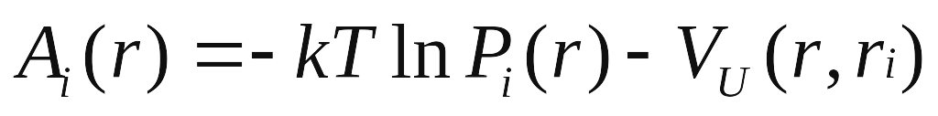
Umbrella sampling
Confining the system using a biasing potential:
To improve sampling we add umbrella potential V_{U} in Hamiltonian and divide system in smaller parts - windows.
In each window:
Putting them all together we get A(r) - overlaps.
- direct method that sample all regions
- require good guess of biasing potential
- post-processing of the data from different windows

Slide 7
4. Potential of mean force
From statistical mechanics:
dΔG/dx = <f(x)>,
Where x is a „reaction“ coordinate and f is the force:
f(x) = -dV(x)/dx.
Then:
ΔG = ∫ <f(x)> dx

Slide 8
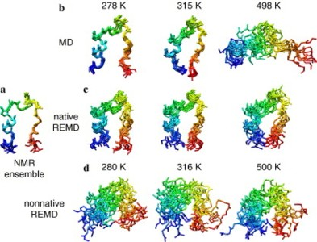
Speeding up direct sampling
Simple annealing: running at elevated temperature
(essentially a scaling transformation)
2. Replica exchange method: running a set of trajectories from
Different initial configurations (q₁⁰, q₂⁰, …, q_{n}⁰) at temperatures
(T₁, T₂, …, T_{n}). After a time interval t new configurations (q₁^{t}, q₂^{t}, …, q_{n}^{t}).
A Monte Carlo attempt to swich configurations:
P_{accept}=min(1,exp(-1/k(1/T_{a}-1/T_{b})(E(q_{a}^{t}) – E(q_{b}^{t}))))

Slide 9
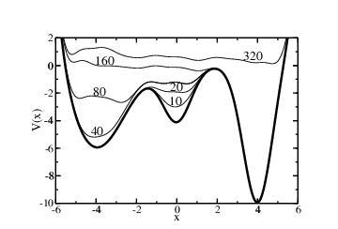
Speeding up direct sampling
3. Metadynamics: filling already visited regions of the phase space
With Gaussians in potential energy. Needs a “reaction coordinate”
4. Adaptive bias force method: Optimization of biasing force to
Achieve uniform sampling along the reaction coordinate.
5. Sampling in the energy space. Computationally efficient,
possible combination with QM/MM

Slide 10
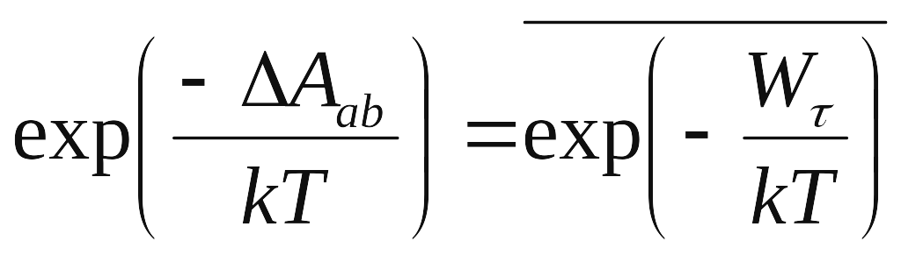
Non-equilibrium simulation
(Fast growth method)
Jarzynski’s method
Averaging the non-reversible work over all
non-equilibrium paths allows to extract the
(equilibrium) free energy difference.
Elegant but typically less efficient than the previous methods.

